Slide 1
PhD Programme in Physics of the University of Bologna
38th Cycle
“Measurements of nuclear fragmentation
differential cross section of a ¹⁶O beam
in an energy range between 200 MeV/n and 400 MeV/n
at the FOOT experiment”
Thesis description presentation
Candidate:
Giacomo Ubaldi
28/06/2022
Notes:
OK in this presentation i want to speak about in vivo monitoring of the dose or of the range in add on therapy what it is about the main methods and research and the first clinical
<numero>

Slide 2

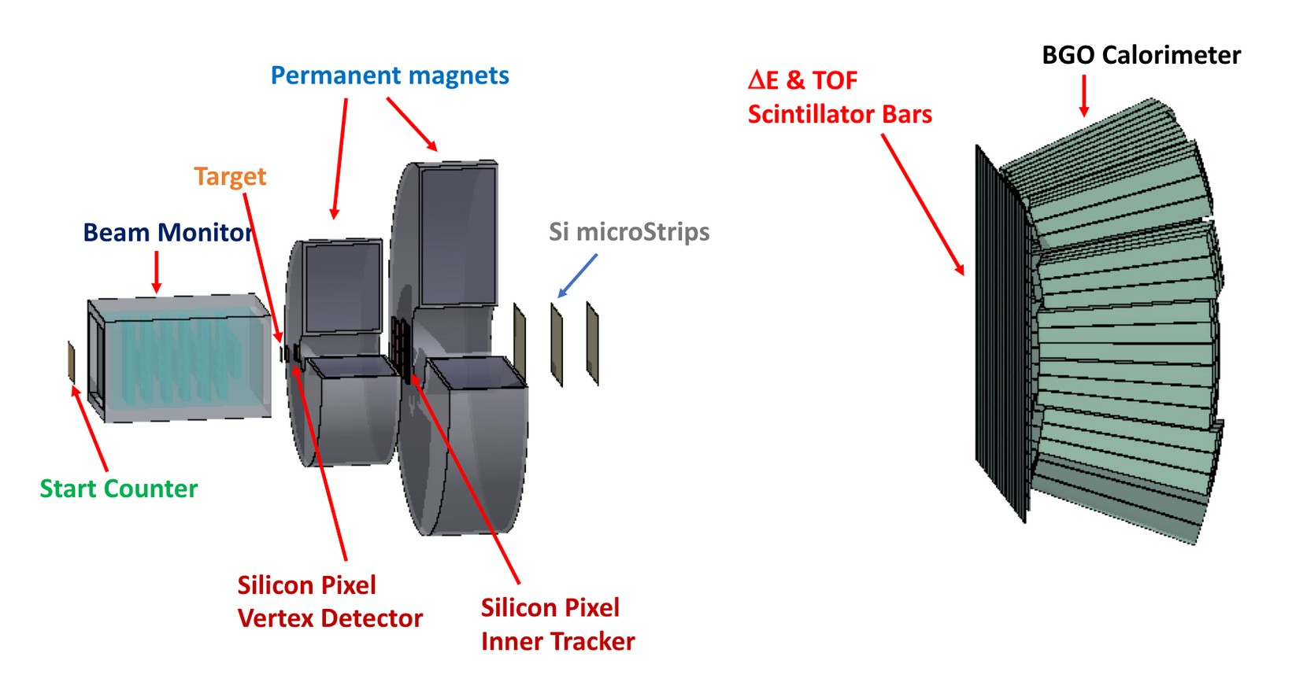
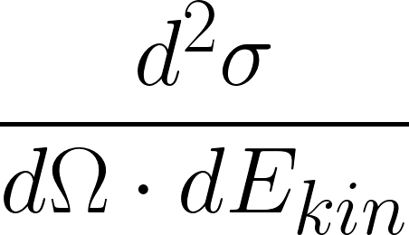
The FOOT experiment
Fixed target experiment with scintillators, magnetic spectrometer, calorimeter
Beams of p,C,O between 200 MeV/u and 700 MeV/u for hadrontherapy and space radioprotection topics
Particle identification by measuring all kinematic quantities
Goal:
Diffential fragmentation cross sections mesurements:
1/

Slide 3


My work
Analysis of data taken at GSI in 2021 of ¹⁶O 400 MeV/u and 200 MeV/u against C as target
Analysis integrated in SHOE (reconstruction software of the collaboration) and optimization for specific data
Partial setup: no tracker, only one module of calorimeter
TW
BM
MSD
SC
VTX
CALO
TG
Specific goal:
Differential fragment cross section:
2/

Slide 4


Event reconstruction
TW charge reconstruction algorithm
dE (MEv)
z=8
z=7
z=6
z=5
z=4
z=3
z=2
z=1
ToF (ns)
Kalman Filter reconstruction of a track
TW
MSD
VT
3/

Slide 5
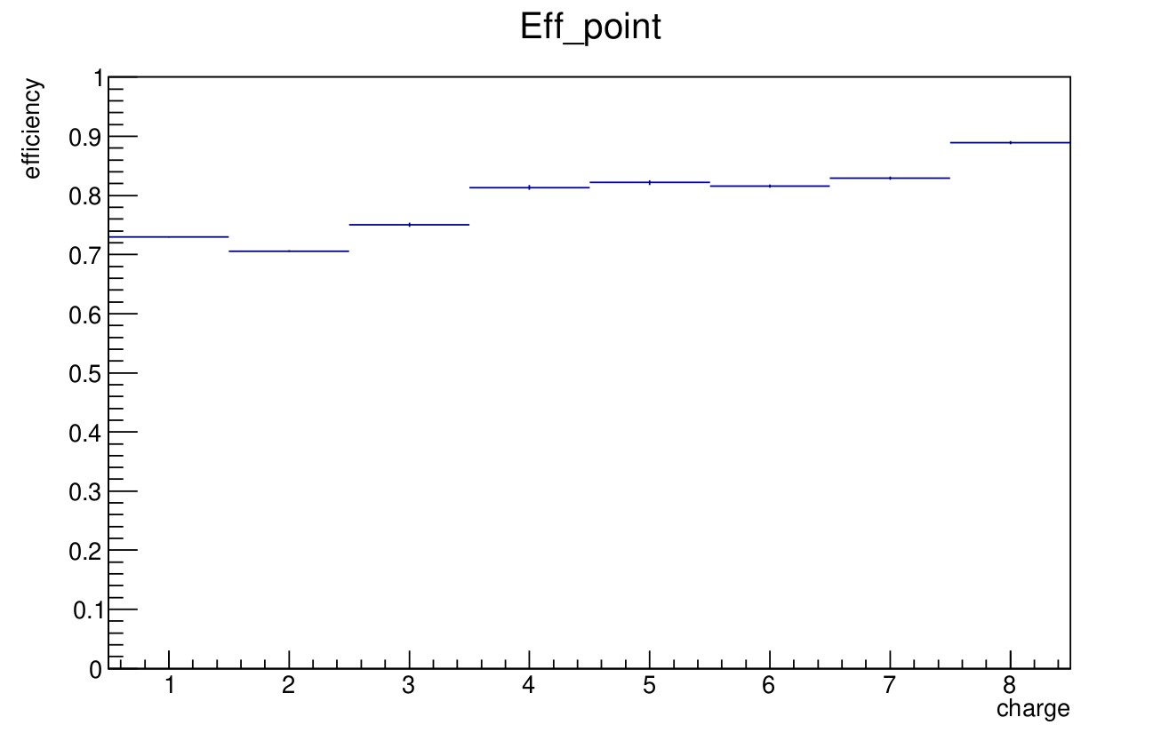
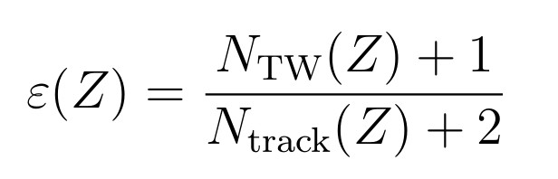
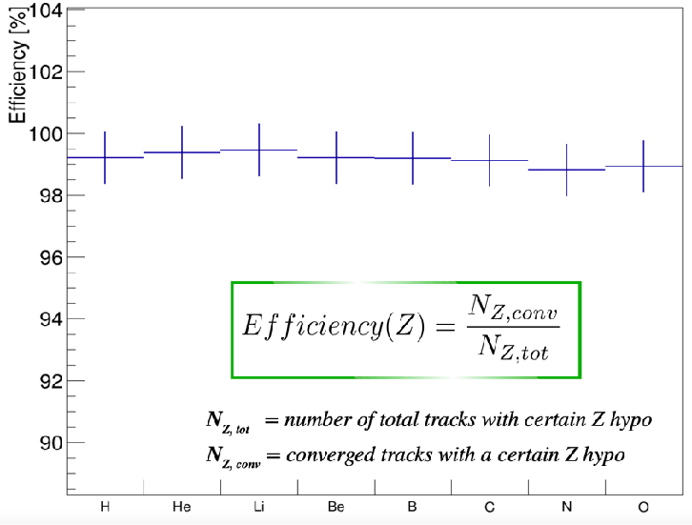
Efficiencies
charge reconstruction efficiency
Track reconstruction efficiency
4/

Slide 6




Pile-up removal
Single projectile
Pileup projectile
Applying a constant threshold discrimination method:
5/

Slide 7

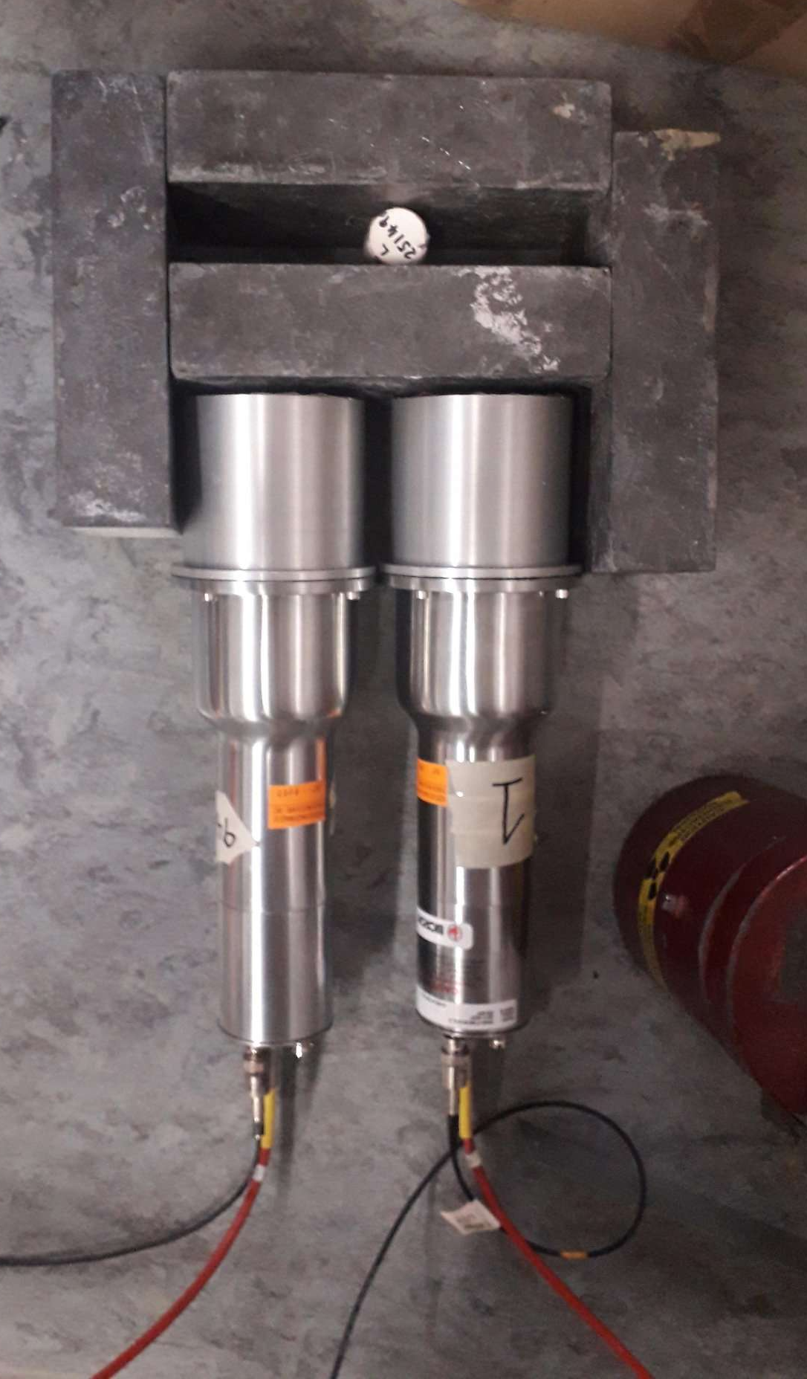
Future prospects
Foreseen:
New data taking with beam of p, ⁴He, ¹²C, ¹⁶O at energies of 200 MeV/u, 400 MeV/n, 800 MeV/n
z
Analysis optimization for all the setup
Implementation of neutron detectors in analysis software
Inverse kinematic application
BC-501A liquid scintillator
6/

Slide 8
Back up slides

Slide 9



Isotopic identification
Mass reconstruction using all FOOT subdetectors:
MC data
5/9

Slide 10




Isotopic identification
Augmented Lagrangian Method
Minimization of
where
MC data
Es. A = 12
A_{ALM} = 11.66 ± 0.38
A/σ_{A} = 3.2 %
χ 2 < 5
5/9

Slide 11


Derivative method
A single signal intersects the thresold lines 4 times: two for the positive and two for the negative ones.
For a pileup signal the intersections are more than 4.
This is at the basis of the constant threshold discrimination method.
2 crosses
4 crosses
2 crosses
4 crosses
Single projectile: 4 crosses
pileup projectile: >4 crosses

Slide 12




Hadrontherapy
tumor
Sketch of a treatment planning system on brain-located tumor
Hadrontherapy vs radiotherapy:
Finite range
Localized dose profile
Nuclear fragmentation
depth- dose profile for X-rays and charged particles as a beam
<numero>
Notes:
Let's start from the beginning. Radiation therapy represents a way to exploit an external beam of radiation, which delivers energy, or those in a specific region of the human body where there is a tumour in order. To kill the tumour cells, or to limit their proliferation. He, according to the kind of radiation in the beam, the delivery of those is different. Let's consider now the dozer profile. So there is of those in terms of depth in the human body and what are the main differences between radiation therapy. Radiotherapy, the most common one which exploits the X rays and add on therapy. The most promising one which uses charged particles. What we can see is that for add on therapy we have a highest physical selectivity, which means that the highest release of those is a focused in a very specific region. Very close to the range. A end of the charged particle and it is called Brad Pick. So according to the energy given to the BMA, it is possible to have a black pika in the specific region of the tumour. We can say. So add on therapy. Can be two favourable with reference to radiotherapy becausr it's hayastan steepest gradient of those releasing just a region makes the highest spare of entity issues before and after the two rural region. However there are also some limits to the best. Then potentiality of this technique, and they are the range uncertainties in the clinical application of my treatment. So after his planning, it is possible that there are some discrepancy in the range of my beam. There can be shift which means. Chiefs of the black Beak in the entity in the tissues of the human body. In particular, there would be another dozing of tissues after the tumour and then under dozing in the two rural region. The consequence of this are that it is possible. to even create damages of arctic issues more than one than the ones of
<numero>

Slide 13
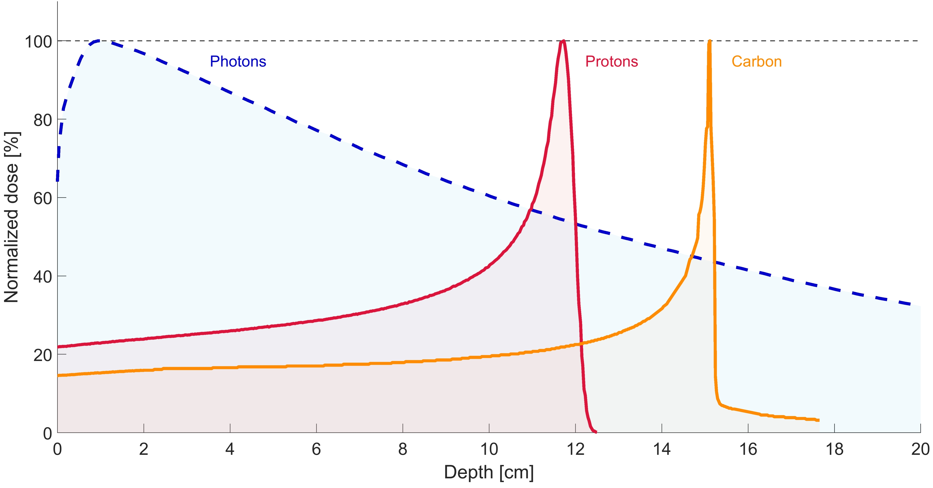
Hadrontherapy
¹²C
Tail after Bragg peak:
nuclear fragmentation!
<numero>
Notes:
Let's start from the beginning. Radiation therapy represents a way to exploit an external beam of radiation, which delivers energy, or those in a specific region of the human body where there is a tumour in order. To kill the tumour cells, or to limit their proliferation. He, according to the kind of radiation in the beam, the delivery of those is different. Let's consider now the dozer profile. So there is of those in terms of depth in the human body and what are the main differences between radiation therapy. Radiotherapy, the most common one which exploits the X rays and add on therapy. The most promising one which uses charged particles. What we can see is that for add on therapy we have a highest physical selectivity, which means that the highest release of those is a focused in a very specific region. Very close to the range. A end of the charged particle and it is called Brad Pick. So according to the energy given to the BMA, it is possible to have a black pika in the specific region of the tumour. We can say. So add on therapy. Can be two favourable with reference to radiotherapy becausr it's hayastan steepest gradient of those releasing just a region makes the highest spare of entity issues before and after the two rural region. However there are also some limits to the best. Then potentiality of this technique, and they are the range uncertainties in the clinical application of my treatment. So after his planning, it is possible that there are some discrepancy in the range of my beam. There can be shift which means. Chiefs of the black Beak in the entity in the tissues of the human body. In particular, there would be another dozing of tissues after the tumour and then under dozing in the two rural region. The consequence of this are that it is possible. to even create damages of arctic issues more than one than the ones of
<numero>

Slide 14

Space radioprotection
Dose equivalent
Dose
Fluence
Particles contribution in
Fluence, dose and equivalent dose
GCR fluence

Slide 15
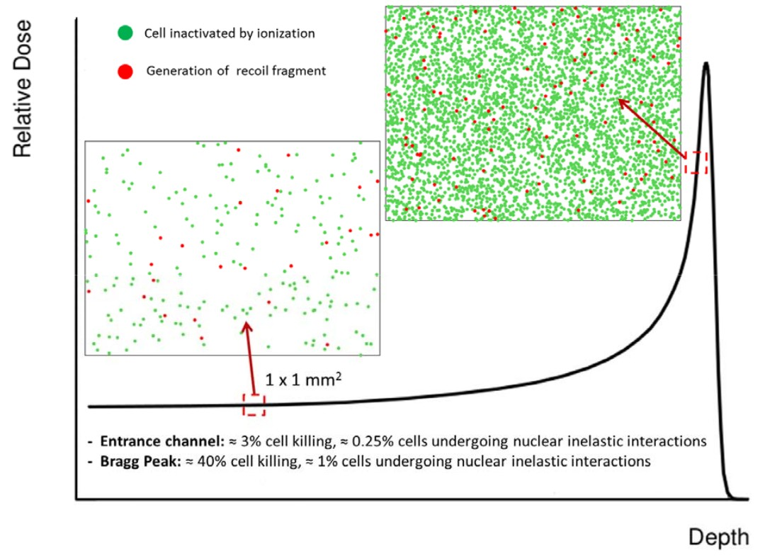


Nuclear Fragmentation
Proton beam:
~ 200 MeV
Damage in all the path
Carbon beam:
~ 400 MeV/u
BEAM
Sketch of Nuclear fragmentation
Damage after the BP

Slide 16
The FOOT detector
Calorimeter
Target
Permament
Magnets
Start
Counter
Beam
monitor
BEAM
z
Vertex
Tracker
Inner
Tracker
Microstrip Silicon
Detector
ToF Wall
Pre-target region
Tracking region
Downstream region

Slide 17
Differential Cross section
Yield of all fragments
Background
unfolding
efficiency
N° of primary
events
N° of scattered
centers
Phase space

Slide 18
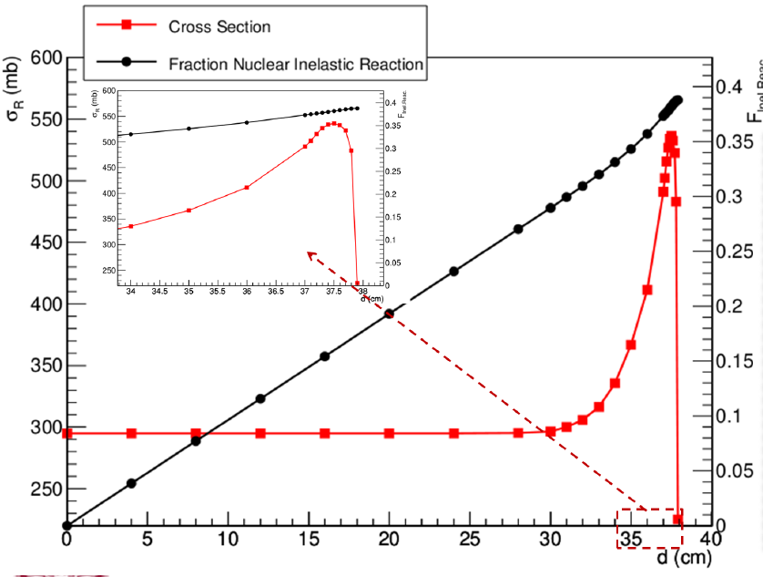
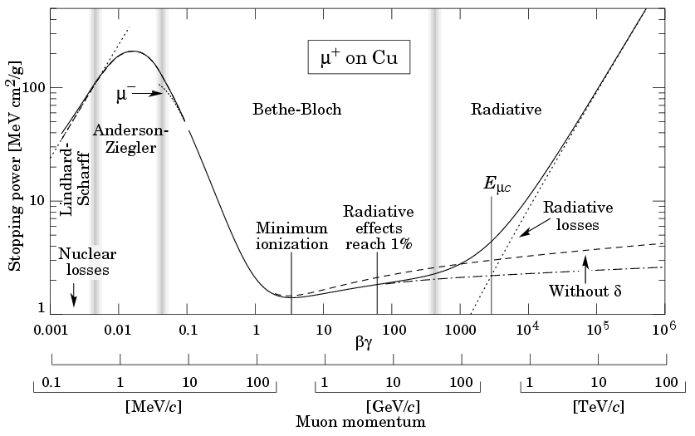
Bethe Bloch vs nuclear cross section

Slide 19
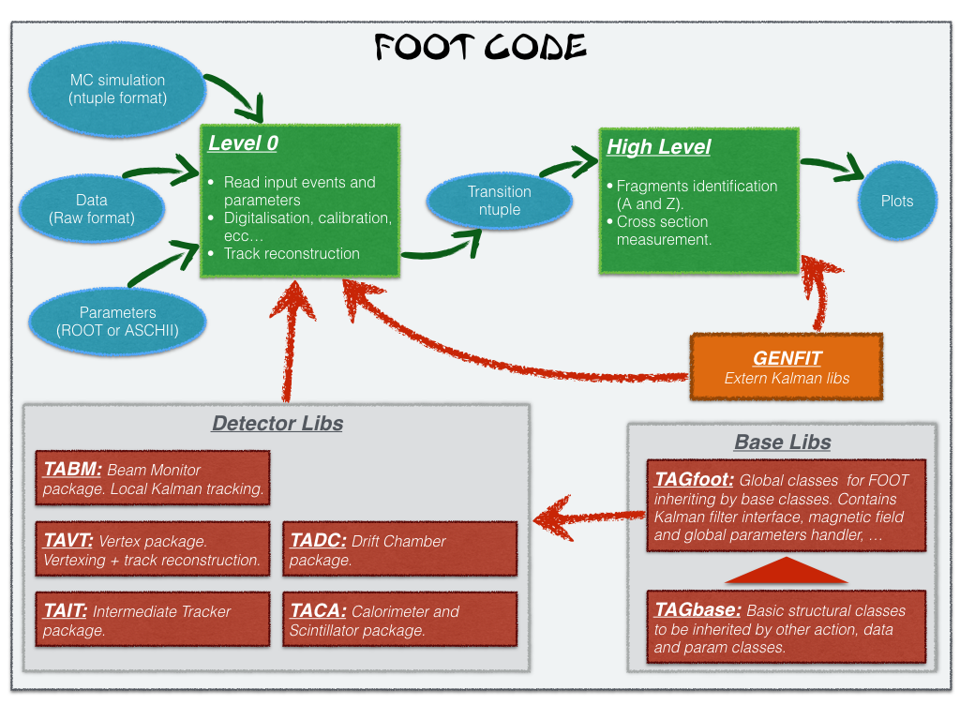
SHOE organization

Slide 20

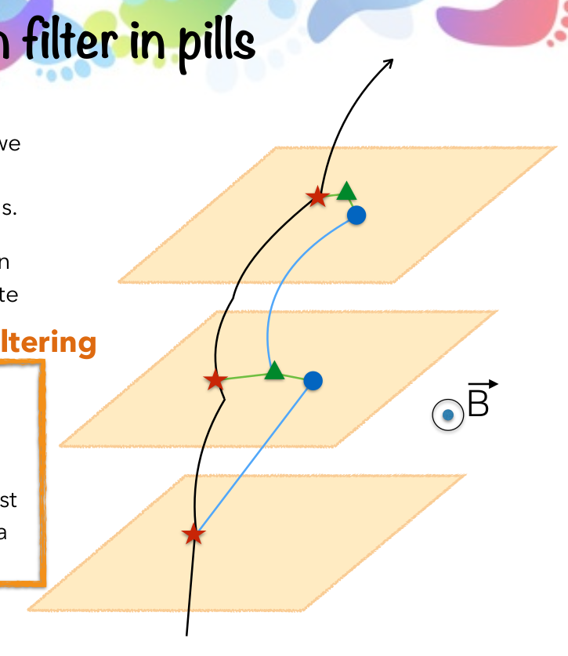
Kalman filter
1. Take an ideal particle in vacuum. If we
add air + detector layers, trajectory
changes due to M.S. and energy loss.
2. We’ll see some measurement hits on
the detector layers (considering finite
detector uncertainty).
3. Propagate the first hit to the next
layer. Propagator Matrix F.
4. Find the best compromise between
the propagated point and the closest
hit on the 2 nd layer. Use a Chi2 and a
Projection Matrix H.
5. Iterate 3 and 4 for the next layers.
Kalman Filter reconstruction of a track
Start from VT tracklets
Projection to possible planes of IT
KF extrapolation to MSD
KF extrapolation to TW
Fit the track candidates and extract reconstructed quantities: es. momentum

Slide 21
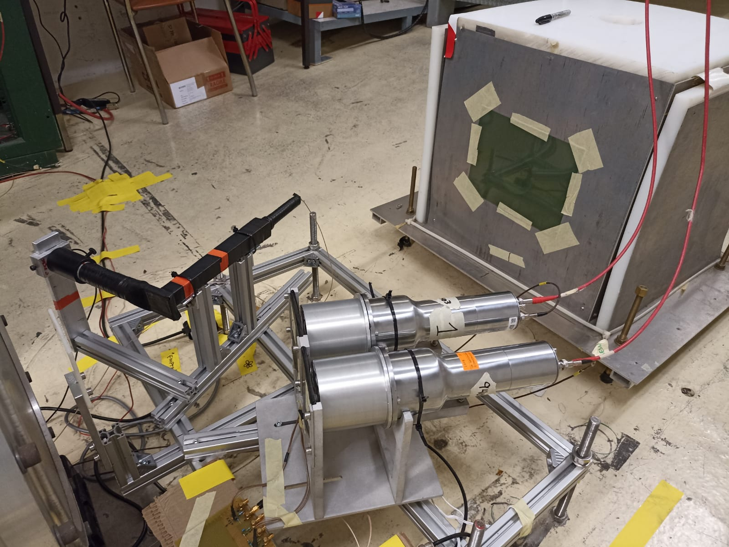
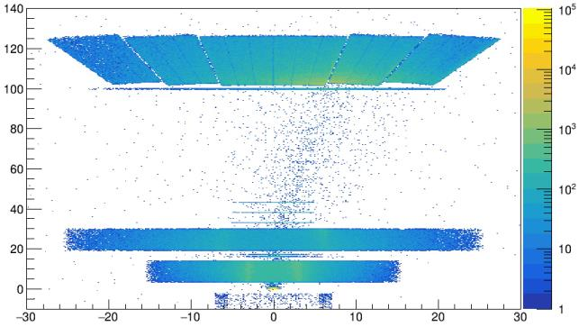
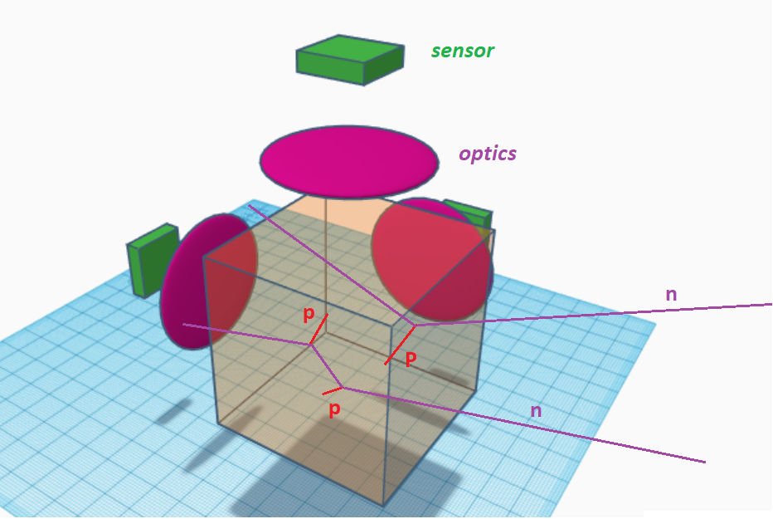
Fast neutrons detectors
High neutron production as a
consequence of fragmentation with detectors
BGO_p
CAL
TW
NIKEs
Purpose to
add neutron
detectors:
BC-501A liquid scintillator
BGO Phoswich
MSD
VT + TARGET
recoil-proton track
imaging detector
7/9

Slide 22
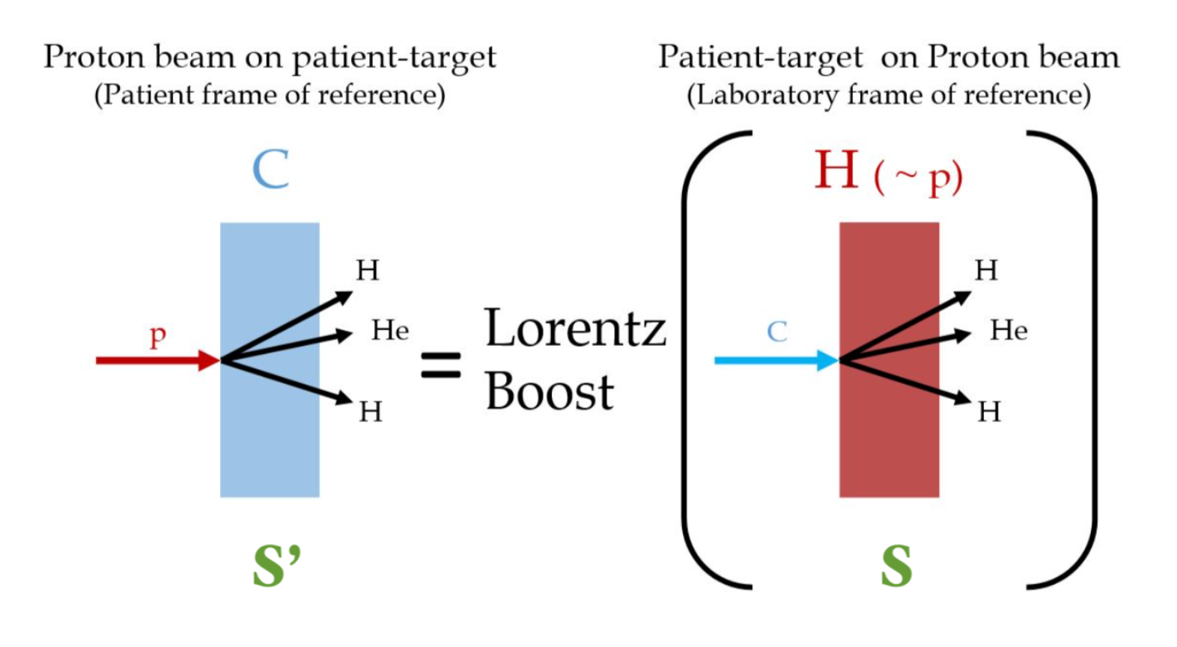
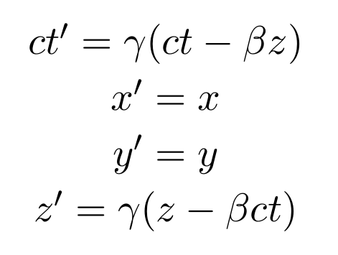
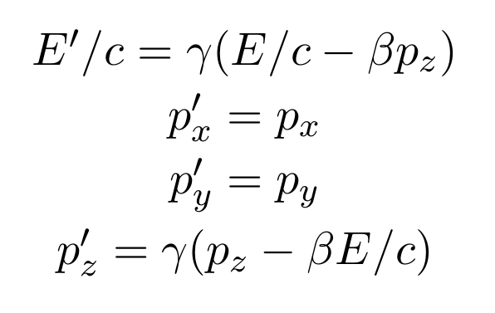
Inverse kinematics

